Slide 1
CST 370 – ADVANCED ALGORITHMS
Dynamic Programming I

Slide 2
Objectives
You will be able to…
Define the concepts of overlapping sub-problems and optimal sub-structure in various problems.
Identify the properties of overlapping sub-problems and optimal sub-structure in Bellman-Ford and Floyd-Warshall.
Practice breaking down various problems into distinct sub-problems that exhibits the above properties.

Slide 3
Do Now
Consider the Fibonacci Sequence. Here’s code that computes the nth Fibonacci number.
int fib(int n) {
if (n == 0 || n == 1) {
return n;
}
return fib(n – 1) + fib (n – 2);
}

Slide 4

Sub Problems
Each recursive call is a “sub-problem” for Fibonacci.
fib(2) is a “smaller” version of the fib(3) problem.
fib(1) is a “smaller” version of fib(2).
fib(0) is also a “smaller” version of fib(2).
fib(3)
fib(2)
fib(1)
fib(1)
fib(0)

Slide 5
Sub Problems
The sub-problems combine to solve the original problem.
int fib(int n) {
if (n == 0 || n == 1) {
return n;
}
return fib(n – 1) + fib (n – 2);
}
fib(3)
fib(2)
fib(1)
fib(1)
fib(0)

Slide 6
Optimal Sub-Structure
When the optimal solution to sub-problems can be combined to get the optimal solution of the original problem, then the problem exhibits Optimal Sub-Structure.
int fib(int n) {
if (n == 0 || n == 1) {
return n;
}
return fib(n – 1) + fib (n – 2);
}
fib(3)
fib(2)
fib(1)
fib(1)
fib(0)

Slide 7
Do Now
Draw the recursive tree for finding the 5th Fibonacci number.

Slide 8
Do Now
Draw the recursive tree for finding the 5th Fibonacci number.
fib(5)
fib(4)
fib(3)
fib(3)
fib(2)
fib(2)
fib(1)
fib(2)
fib(1)
fib(1)
fib(0)
fib(1)
fib(0)
fib(1)
fib(0)

Slide 9
Do Now
Draw the recursive tree for finding the 5th Fibonacci number.
fib(5)
fib(4)
fib(3)
fib(3)
fib(2)
fib(2)
fib(1)
fib(2)
fib(1)
fib(1)
fib(0)
fib(1)
fib(0)
fib(1)
fib(0)

Slide 10
Do Now
Draw the recursive tree for finding the 5th Fibonacci number.
fib(5)
fib(4)
fib(3)
fib(3)
fib(2)
fib(2)
fib(1)
fib(2)
fib(1)
fib(1)
fib(0)
fib(1)
fib(0)
fib(1)
fib(0)

Slide 11
Do Now
Draw the recursive tree for finding the 5th Fibonacci number. What looks inefficient about it?
Some sub-problems (i.e., fib(3), fib(2), the base cases) are computed multiple times.

Slide 12
Do Now
Draw the recursive tree for finding the 5th Fibonacci number. What looks inefficient about it?
Some sub-problems (i.e., fib(3), fib(2), the base cases) are computed multiple times.
These are called overlapping sub-problems.

Slide 13
Overlapping Sub-Problems
The overlapping sub-problems property means that the same sub-problems are being solved multiple times.
fib(5)
fib(4)
fib(3)
fib(3)
fib(2)
fib(2)
fib(1)
fib(2)
fib(1)
fib(1)
fib(0)
fib(1)
fib(0)
fib(1)
fib(0)

Slide 14
Dynamic Programming
Problems that exhibit both Optimal Sub-Structure and Overlapping Sub-Problems properties are great candidates for solving with a dynamic programming algorithm.
Notes:
https://www.geeksforgeeks.org/dynamic-programming-set-1/

Slide 15
Dynamic Programming
Dynamic programming (DP for short) is a problem-solving technique where we store the solutions to overlapping sub-problems to avoid computing them again.
Dynamic programming explicitly trades of Space complexity for Time complexity.
Notes:
https://www.geeksforgeeks.org/dynamic-programming-set-1/

Slide 16
Dynamic Programming
Identifying Dynamic Programming Problems.
Typically most DP problems involve one of the following:
Finding the Maximum or Minimum of something
Optimizing (finding the best/worst) of something.
Counting the total number of something.
Notes:
If a problem exhibits these things, you can “consider” using dynamic programming, that doesn’t mean DP is always the right way to go. Maybe you’re trying to find the shortest path in a maze. We can use other algorithms like BFS/DFS for that.

Slide 17
Dynamic Programming
Examples
Where have we seen this before?

Slide 18
Dynamic Programming
Examples
Where have we seen this before?
Bellman-Ford and Floyd-Warshall!

Slide 19
Dynamic Programming
Examples
Where have we seen this before?
Bellman-Ford and Floyd-Warshall!
Let’s review these algorithms and see why they’re dynamic programming algorithms.

Slide 20
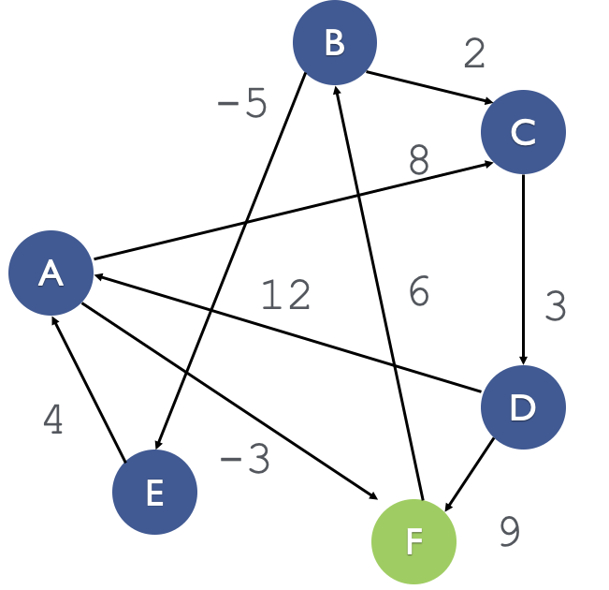
Bellman-Ford
Problem
Find the shortest path from one node to all other nodes in a graph
Single Source Multi Destination.

Slide 21
Bellman-Ford
Algorithm
Initialize a map of nodes to distances, dist. Set distance to the origin node = 0 and to every other node = max_int/infinity.
Iterate over number of vertices minus 1 (k, the potential max number of edges on our shortest paths):
Iterate over all the edges, (u,v) :
If dist[u] is infinity, skip it: we cannot reach that vertex yet.
If there is a shorter path to v through u, update the distance in dist[v]: (i.e., dist[v] > dist[u] + weight(u,v))
Return the distance map.

Slide 22
Bellman-Ford
Idea - Breaking into sub-problems
Bellman Ford’s key observation is to use the number of edges in a path as the indicator of what “sub-problem” means.
A path made with at most 2 edges is smaller than a path made with at most 3 edges. (For our definition of smaller).

Slide 23
Bellman-Ford
Idea - Optimal Sub-Structure
If we have the optimal solution to a sub problem, can we use that to get the optimal solution of the original problem?

Slide 24
Bellman-Ford
Idea - Optimal Sub-Structure
Assume dist[N] stores the shortest path from our source S to N using at most 2 edges.
We can look the every edge in the graph and say “For an edge U-V, the shortest path from S to V with at most 3 edges would either be dist[V] or dist[u] + U-V.

Slide 25
Bellman-Ford
Idea - Overlapping Sub-Problems
Does the answer to one sub-problem get reused multiple times when solving for the original problem?

Slide 26
Bellman-Ford
Idea - Overlapping Sub-Problems
Look at edges from C.
When finding shortest paths from F with at most 3 edges, we’re going to need the shortest path from F to C with at most 2 edges for each edge CB, CA, CD.

Slide 27
Bellman-Ford
Algorithm
Initialize a map of nodes to distances, dist. Set distance to the origin node = 0 and to every other node = max_int/infinity.
Iterate over number of vertices minus 1 (k, the potential max number of edges on our shortest paths):
Iterate over all the edges, (u,v) :
If dist[u] is infinity, skip it: we cannot reach that vertex yet.
If there is a shorter path to v through u, update the distance in dist[v]: (i.e., dist[v] > dist[u] + weight(u,v))
Return the distance map.

Slide 28
Bellman-Ford
Dynamic Programming
Bellman-Ford picked a sub-problem where it was possible to get optimal sub-structure and overlapping sub-problems.
It also stored the results of the sub-problems so we don’t have to recompute them all the time.
Therefore Bellman-Ford is a Dynamic Programming Algorithm.

Slide 29
Bellman-Ford
Dynamic Programming
Defining the sub-problem is key.
Bellman-Ford picked a sub-problem where it was possible to get optimal sub-structure and overlapping sub-problems.

Slide 30
Floyd-Warshall
Problem
Find the shortest path between any two pairs of nodes in a graph.
All-pairs shortest path.

Slide 31
Floyd-Warshall
Problem
Break it into sub-problems.
Do the sub-problems form an optimal sub-structure?
Do the sub-problems overlap?

Slide 32
Floyd-Warshall
Idea - Breaking into sub-problems
Floyd’s algorithm looked at the number of intermediate nodes a path passes through and used that to create smaller problems.
A shortest path between two random nodes that goes through at most 3 nodes {a,b,c} is smaller than one that goes through at most 4 nodes {a,b,c,d}.

Slide 33
Floyd-Warshall
Problem
Break it into sub-problems.
Do the sub-problems form an optimal sub-structure?
Do the sub-problems overlap?

Slide 34
Floyd-Warshall
Idea - Optimal Sub-Structure
Assume shortest[X][Y] stores the shortest paths between any X,Y going through at most 3 nodes {a,b,c}.
For the node d, the shortest path to get from two any nodes X,Y is either shortest[X][d] + shortest[d][Y} or shortest[X][Y].

Slide 35
Floyd-Warshall
Problem
Break it into sub-problems.
Do the sub-problems form an optimal sub-structure?
Do the sub-problems overlap?

Slide 36
Floyd-Warshall
Idea - Overlapping Sub-Problems
The shortest path between X & Y will be used when trying to calculate the shortest path between X and some other node through Y.
Once we’ve found the shortest path between X & Y, we will have to use it over-and-over again.

Slide 37
Floyd-Warshall
Algorithm
Initialize a V x V distance matrix, dist, to the adjacency matrix.
Iterate over the vertices (k, the number of vertices we can go through on our path):
Iterate over the vertices (j, the possible destination nodes):
Iterate over the vertices (i, the possible source nodes):
If there is a shorter route from i to j through k, update the distance in dist[i][j] (i.e., dist[i][k] + dist[k][j] < dist[i][j])
Return the distance matrix

Slide 38
Floyd-Warshall
Dynamic Programming
Floyd-Warshall picked a sub-problem where it was possible to get optimal sub-structure and overlapping sub-problems.
It also stored the results of the sub-problems so we don’t have to recompute them all the time.
Therefore Bellman-Ford is a Dynamic Programming Algorithm.

Slide 39
Floyd-Warshall
Idea
Defining the sub-problem is key.
Floyd-Warshall picked a sub-problem where it was possible to get optimal sub-structure and overlapping sub-problems.

Slide 40
Dynamic Programming
How to break a problem down
Identify that you can use DP for the problem – i.e., that it has the overlapping sub-problems and optimal sub-structure problems. Often DP problems ask you to minimize or maximize something or count possibilities under certain conditions.

Slide 41
Dynamic Programming
How to break a problem down
Identify that you can use DP for the problem – i.e., that it has the overlapping sub-problems and optimal sub-structure problems. Often DP problems ask you to minimize or maximize something or count possibilities under certain conditions.
Determine the state. The state is a collection of parameters that uniquely identify a sub-problem. The state will used to store and retrieve results.

Slide 42
Dynamic Programming
How to break a problem down
Identify that you can use DP for the problem – i.e., that it has the overlapping sub-problems and optimal sub-structure problems. Often DP problems ask you to minimize or maximize something or count possibilities under certain conditions.
Determine the state. The state is a collection of parameters that uniquely identify a sub-problem. The state will used to store and retrieve results.
Determine the relationship between states; i.e., how to find a state from smaller states.

Slide 43
Lab
Consider the Fibonacci Sequence. Here’s code that computes the nth Fibonacci number.
int fib(int n) {
if (n == 0 || n == 1) {
return n;
}
return fib(n – 1) + fib (n – 2);
}

Slide 44
Lab
Fibonacci Numbers
Break it into sub-problems.
Do the sub-problems form an optimal sub-structure?
Do the sub-problems overlap?

Slide 45
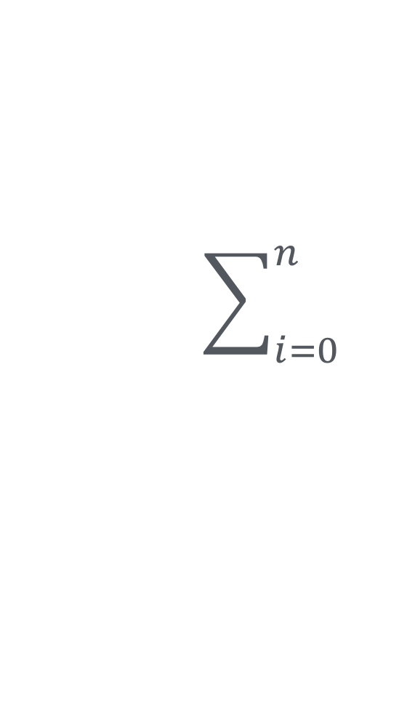
Lab
Catalan Numbers
The Catalan numbers, like the Fibonacci numbers, are a sequence of natural numbers. The first Catalan number is defined C₀ = 1 and thereafter C_{n+1} = C_{i}C_{n-i}.
For example,
C₁ = C₀C₀ = 1 * 1 = 1
C₂ = C₀C₁ + C₁C₀ = 1 * 1 + 1 * 1 = 2
C₃ = C₀C₂ + C₁C₁ + C₂C₀ = 1 * 2 + 1 * 1 + 2 * 1 = 5
C₄ = C₀C₃ + C₁C₂ + C₂C₁ + C₃C₀ = 1 * 5 + 1 * 2 + 2 * 1 + 5 * 1 = 14

Slide 46
Lab
Catalan Numbers
Break it into sub-problems.
Do the sub-problems form an optimal sub-structure?
Do the sub-problems overlap?

Slide 47
Lab
The Knapsack Problem
Suppose we have n items and a knapsack. Each item has a monetary value and a physical weight. (These are stored in arrays of integers where corresponding indices indicate the value and weight for the same number.) We want to find the maximum value of objects we can carry without exceeding the weight limit w of the knapsack.

Slide 48
Lab
The Knapsack Problem
Mark Zuckerberg says he’ll buy you anything from Best Buy as long as you can fit it in a shopping cart. The cart can hold at most x lbs. how do you pick the most expensive things to fit into the cart and get for free?

Slide 49
Lab
The Knapsack Problem
Mark Zuckerberg says he’ll buy you anything from Best Buy as long as you can fit it in a shopping cart. The cart can hold at most x lbs. how do you pick the most expensive things to fit into the cart and get for free?

Slide 50
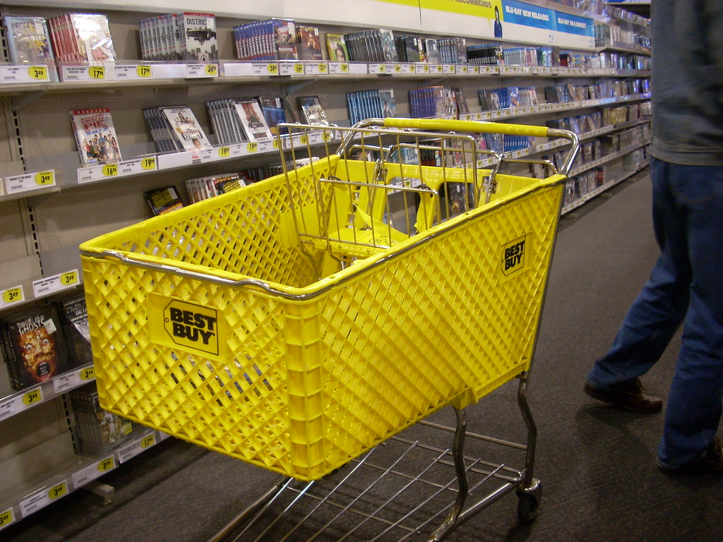
Lab
The Knapsack Problem
num_items = 3
value[] = [60, 100, 120]
weights[] = [15, 15, 15]
cart_limit = 30

Slide 51
Lab
The Knapsack Problem
Break it into sub-problems.
Do the sub-problems form an optimal sub-structure?
Do the sub-problems overlap?

Slide 52
Lab
The Knapsack Problem
Break it into sub-problems.
hint: A given item, can either be in the cart or not.
Do the sub-problems form an optimal sub-structure?
Do the sub-problems overlap?

Slide 53
Lab
The Coin change Problem
How many different ways can I pick coins to make a dollar amount? You only have Quarters, Nickels, Dimes, and Pennies.

Slide 54
Lab
The Coin change Problem
Break it into sub-problems.
Do the sub-problems form an optimal sub-structure?
Do the sub-problems overlap?

